Slide 1
Web Development Tools, PHP and MySQL
By
K. Kalyan Kumar
S. Babu Reddy
Ashok Kumar
Kirandeep

Slide 2
Contents
Server Installation
Development Editors
PHP Basics
PHP and MySQL

Slide 3


Servers
Xampp Wampp

Slide 4
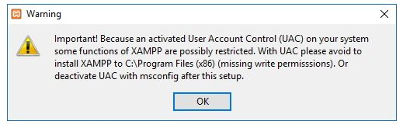
Xampp Installation
Steps :
Open the Apache Friends Website
Download the xampp for windows
Double-click the downloaded file to launch the installer and click on OK
Click on the next Button

Slide 5
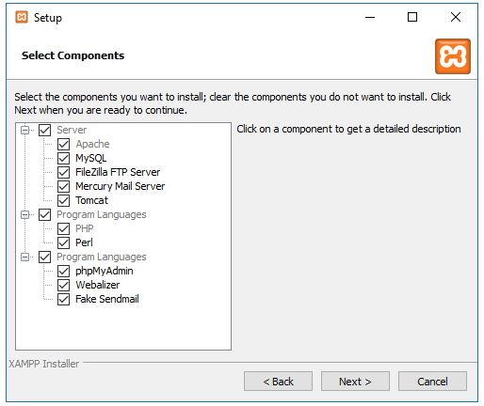
XAMPP offers a variety of components that you can install, such as MySQL, PhpMyadmin, etc. Then select all and click on next.

Slide 6
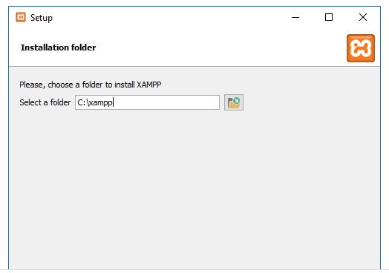
Use the default installed location, or choose another folder to install the software in the “Select a folder” field.
Click on next button

Slide 7
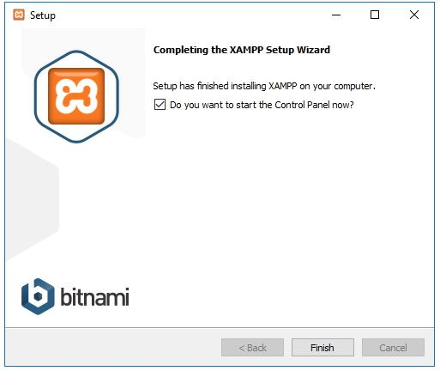
Then, click on the next button and finally click on finish to complete the installation.
Open the xampp and select your language

Slide 8
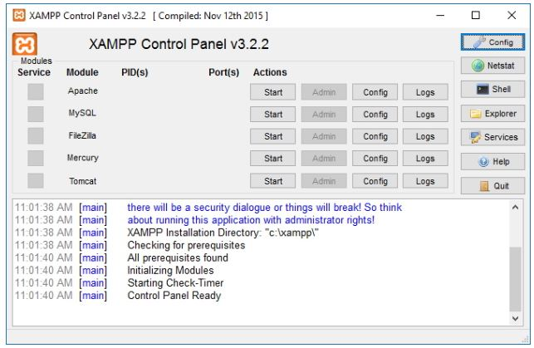
Click the save button
Installation finished successfully.
Open the browser and type ‘ localhost ’, then you will get Apache home page and server started successfully.

Slide 9
Development Editors
Notepad++
Sublime Text
WebStorm
PhpStorm
VS Code
Atom

Slide 10
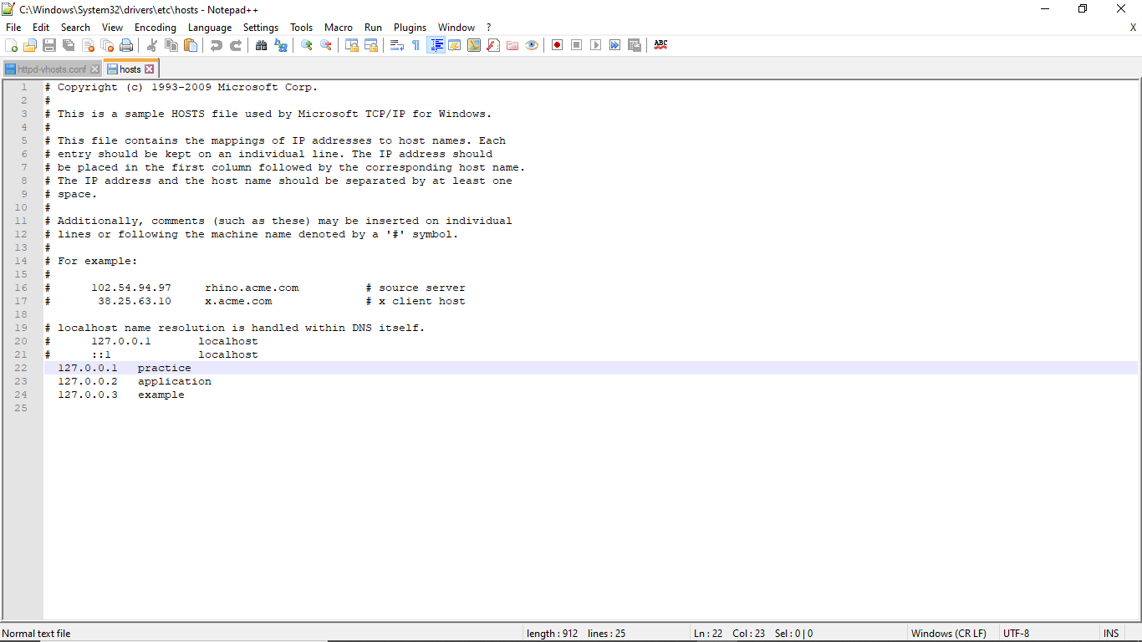

Notepad++

Slide 11
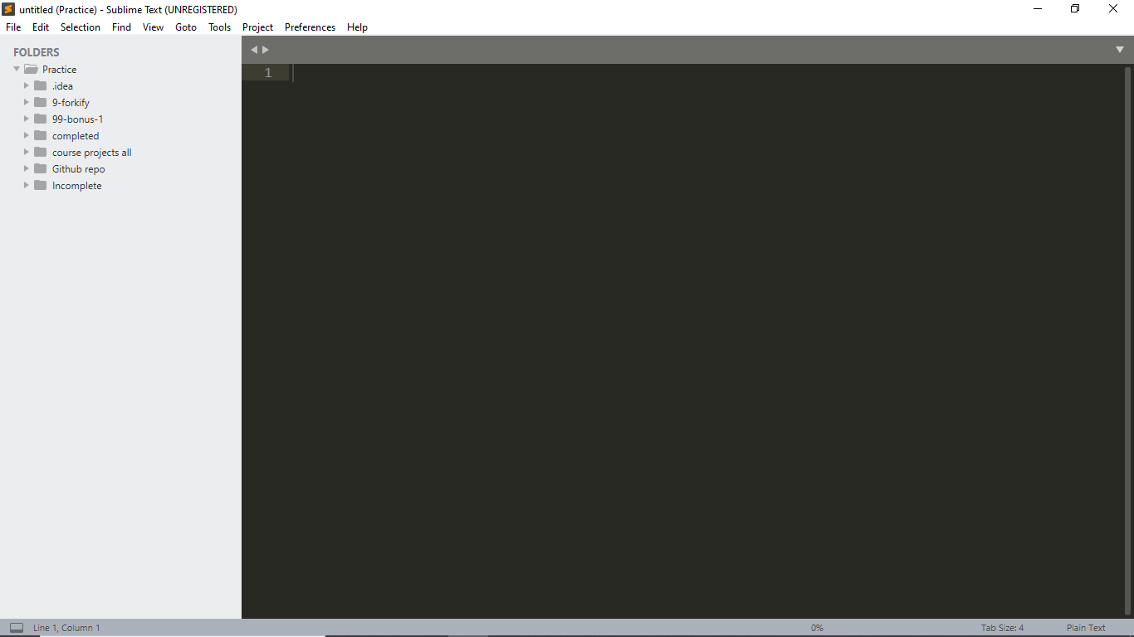

Sublime Text

Slide 12
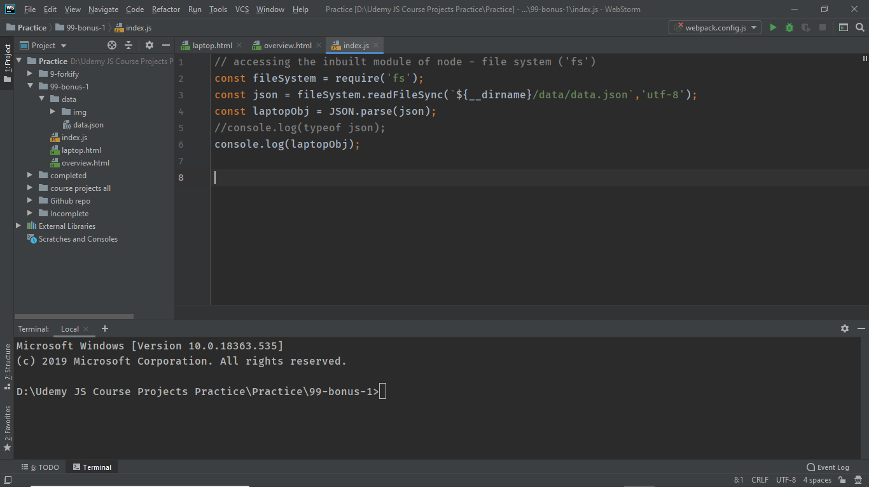

WebStorm

Slide 13
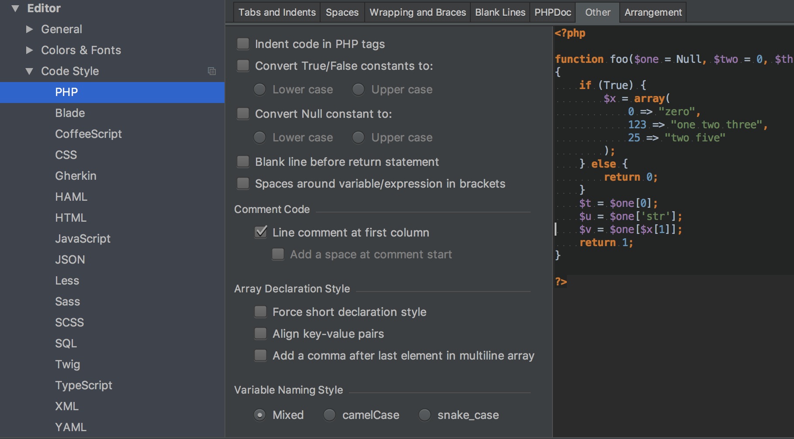

PhpStorm

Slide 14
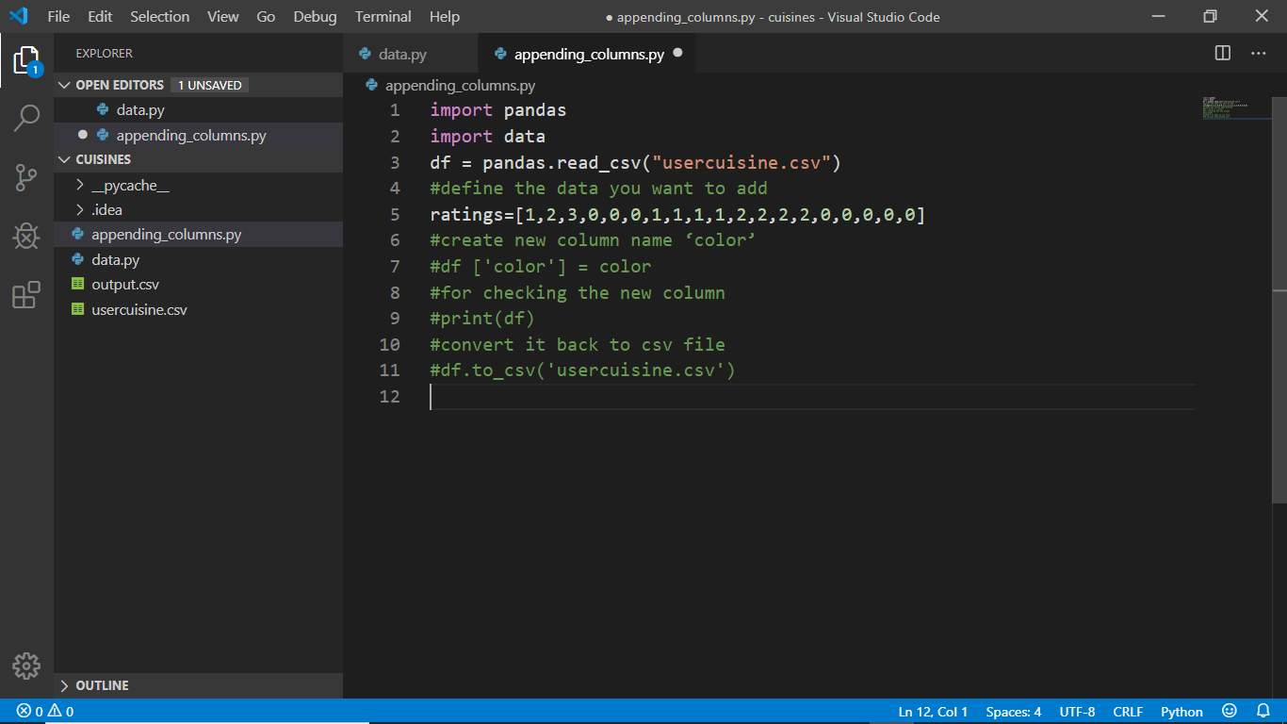

VS Code

Slide 15
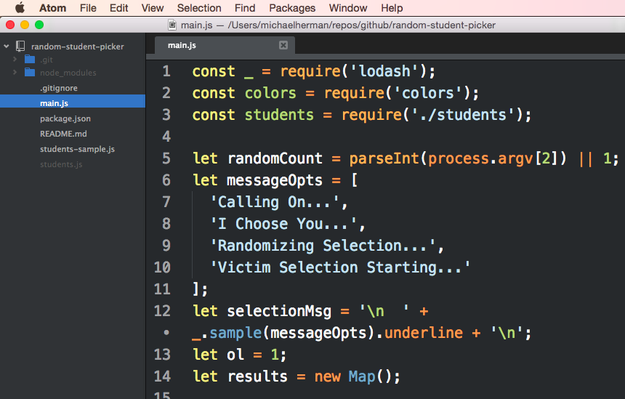

ATOM

Slide 16
PHP Basics
Introduction
PHP Syntax
Echo / Print
Variables
Conditional and Looping Statements
Arrays
Form Handling(GET and POST)

Slide 17
Introduction
PHP is an acronym for "Hypertext Preprocessor"
PHP is a widely-used, open source scripting language
PHP scripts are executed on the server
PHP is free to download and use
Ex : Facebook is still using PHP for application development
PHP supports a wide range of databases
PHP is easy to learn and runs efficiently on the server side
Current version of PHP is PHP 7.2

Slide 18
PHP Syntax
A PHP script can be placed anywhere in the document.
Syntax : <?php ends with ?>
Example :
<!DOCTYPE html> <html> <body> <h1>My first PHP page</h1> <?php echo "Hello World!"; ?> </body> </html>

Slide 19
Echo / Print
With PHP, there are two basic ways to get output:
-> Echo
-> Print
Both the echo and print are used for same purpose to output the data to the screen
Syntax :
<?php Output :
echo "<h2>“Hello World "</h2>"; Hello World print "Study PHP at " Hello World"<br>"; Hello World ?>

Slide 20
Variables
In PHP, a variable starts with the ‘ $ ’ sign, followed by the name of the variable
A variable name must start with a letter or the underscore character
A variable name cannot start with a number
A variable name can only contain alpha-numeric characters and underscores (A-z, 0-9, and _ )
Variables are case Sensitive ( both $name and $Name are different ).

Slide 21
Variables Example
<?php $txt = "Hello world!";
$x = 5;
$y = 10.5; ?>

Slide 22
Conditional Statements
$t = 50 ; if ($t > “70") { echo “ First Class ” ; }
elseif ($t >= “35“ && $t <= 70) { echo “ Second Class ”; }
else { echo “ Fail ”; } ?>
Output : Second Class

Slide 23
Looping Statements
when you write code, you want the same block of code to run over and over again a certain number of times. So, instead of adding several almost equal code-lines in a script, we can use loops.
Some of the examples of loops are For loop , While loop , Do – While, foreach etc.
Syntax : While loop
while (condition is true) { code to be executed; }
Example :
<?php $x = 1; while($x <= 5) { echo “ The number is: $x "; $x++; } ?>

Slide 24
Example
For loop :
Syntax :
for (init counter; test counter; increment counter) { code to be executed for each iteration; }
Example :
<?php for ($x = 0; $x <= 10; $x++) { echo “ The number is: $x “; } ?>

Slide 25
Arrays
An array is a special variable, which can hold more than one value at a time.
In PHP , ‘ array() ‘ function is used to create an array
Ex : <?php
$nums = array();
$nums[] = 10;
$nums[] = 20;
for($i = 0; $i < count($nums); $i++){ output :
echo $cars[$i]; 10
echo "<br>"; 20
}
?>

Slide 26
Methods
Get : Get Method is used to request the data from the Specified Resource
Post : POST is used to send data to a server to create/update a resource.

Slide 27
PHP and MySQL
Intro to MySQL
DB Connection
Query Execution
Printing Data

Slide 28
Intro to MySQL
Relational Database Management System
Database system that runs on a server
It is very fast, reliable, and easy to use database system. It uses standard SQL.

Slide 29
DB CONNECTION
mysqli_connect( )
It requires 4 parameters
Server Name
Username
Password
Dbname
Ex.
mysqli_connect($servername, $username, $password, $dbname);

Slide 30
Query Execution
mysqli_query( )
Executes query and returns resultant array
It requires 2 parameters
Connection String
Query
Ex.
$Result=mysqli_query($conn, $Select_Books);

Slide 31
Query Execution
mysqli_num_rows( )
Returns row count
Eg.
$count = mysqli_num_rows($result);

Slide 32
PRINTING DATA
mysqli_fetch_array( );
It takes the resultant array and returns the associative array
Eg.
While($row = mysqli_fetch_array($result))
{
Echo $row[‘column_name‘];
}

Slide 33
Thank you

